Slide 1
@$ cf}+ e"sDk ;'/Iff lbj; e"sDkLs ;r]tgf, ;'/lIft ;+/rgf Role of CSO in Earthquake Safty campaign e"sDkLo ;'/Iff cleofgdf gfu/Ls ;+:yfx?sf] e"ldsf
k|:tf]tf
lji0f' k|;fb ltldlN;gf
Dfxf;lrj, /fli6o ljkb Joj:yfkg ;~hfn g]kfn
-l8dfg_

Slide 2
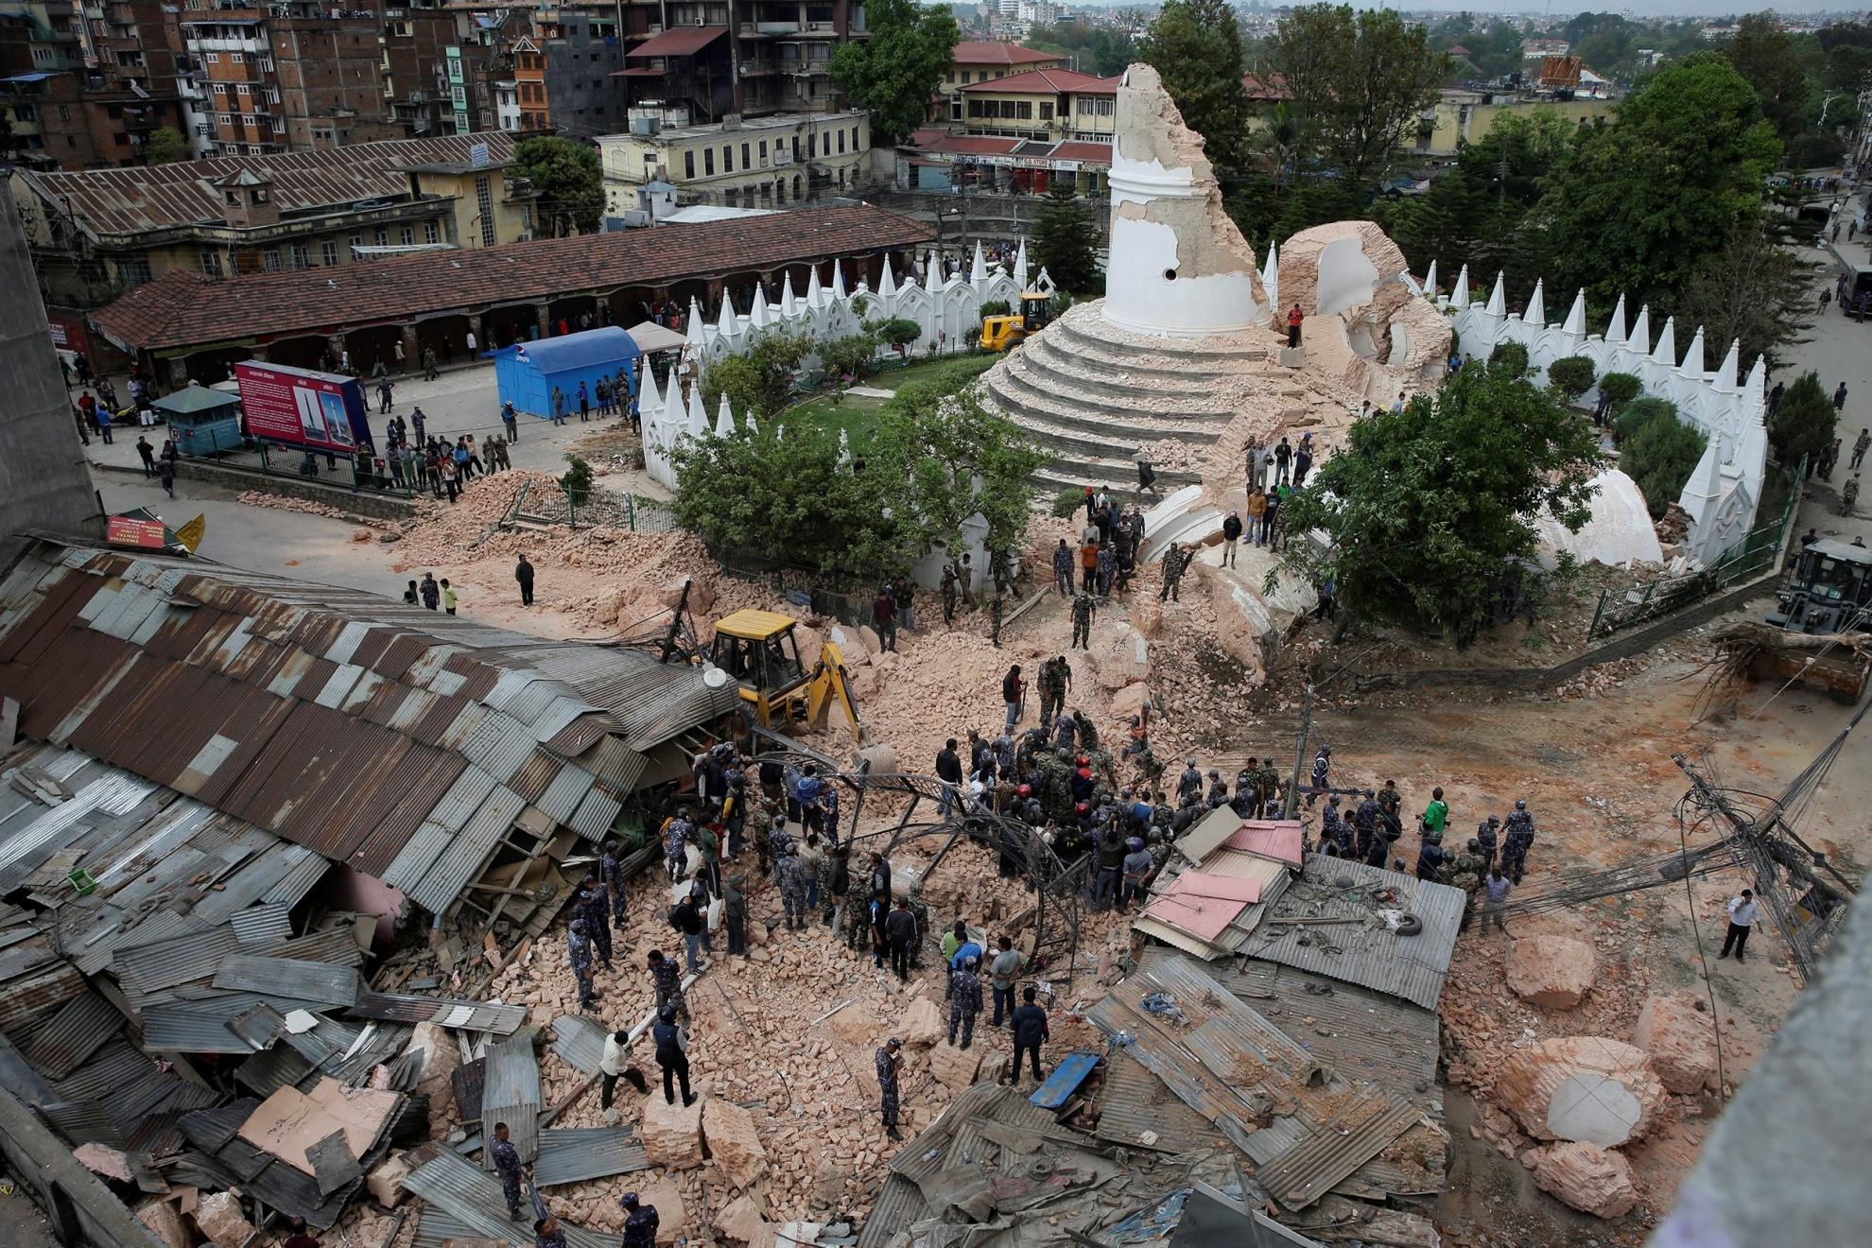
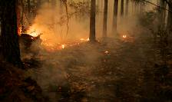
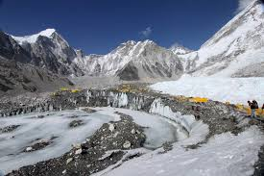
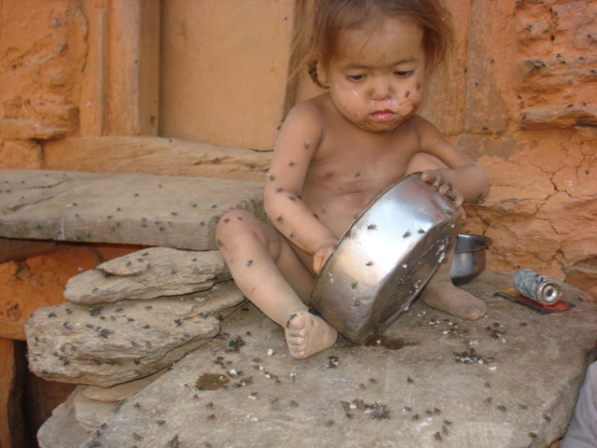
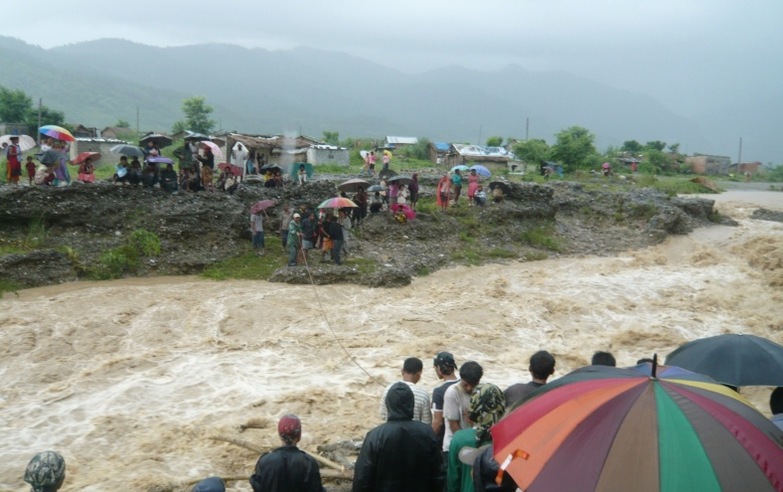
ljkb / dfgjLo ;+s6df g]kfn ljkb\sf k|d'v sf/0fx?
e"sDkLo b[li6n] !!cf+} jf9L klx/f] hGo k|sf]ksf b[li6n] #) cf}+ / hnjfo' kl/jt{sf b[li6n] rf}yf] :yfgdf ;8s b'3{6gf af6 %) cf} / e"sDkLo hf]lvdo'Qm zx/x?df sf7df8f} klxnf] :yfgdf /x]sf] 5 .
r6\ofª,
gfsfjGbL, r/d ul/jL
k|fs[lts
e"sDk, jf9L klx/f], lxdkft, lxdklx/f], cl;gfkfgL, cltj[li6«, cgfa[li6 v8]/L, x'l/atf;, zLtnx/, r6\ofª,
u}/ k|fs[lts
dxfdf/L, cfunfuL, clgsfn, 89]nf], sL6cftª\s, a8{ˆn', hgfj/ cftª\s, xjfO tyf ;8s b'36gf, cfGtl/s 4G4, jGb, x8tfn gfsfjGbL

Slide 3
oyfy{df g]kfndf e"sDk
e"sDk g]kfndf h'g;'s} a]nf klg cfpg ;S5 .
g]kfndf k6s k6s 7"nf ;fgf e"sDk / e"sDk kl5 k/fqmdgx? cfPsf] ljutsf Oltxfl;s tYofÍ / cg'ejx? xfd|f ;fd' 5g\ .
!(() / @)&@ sf] e"sDk x/]s g]kfnLsf nflu :d/0fof]Uo /xb} cfPsf 5g\ .
e"sDk /f]Sg] s'g} k|ljwLsf] ljsf; ePsf] 5}g .
e"sDk cfpg] k"j{ ;"rgf k|0ffnLsf] cem} ljsf; ePsf] 5}g .
e"sDkn] ljkb\ lgDtfPsf] xf]Og , sdhf]/ ;+/rgf / e"sDkLo hf]lvd Go"gLs/0fsf] k"j{ tof/Lsf cefjsf sf/0f g]kfnLn] ljkb\sf] ;fdfgf ug{'kg]{ jfWotf /xb} cfPsf] 5 .

Slide 4
e"sDksf] k|efj
e"sDk
tTsfnLg k|efj
lb3{sfnLg k|efj

Slide 5
tTsfnLg k|efj
dlg;sf] d[To', 3fOt] tyf rf]6 k6s nfUg', nf; km]nf gkg‘{ cflb
dfgjLo Iflt
;l~rt wgsf] Iflt, ef}lts ;+/rgfsf] Iflt, e"ldsf] Iflt, afnL–gfnLsf] Iflt, kz'wgsf] Iflt, ;fj{hflgs ;DklQsf] Iflt cflb
cfly{s Iflt

Slide 6
bL3{sfnLg k|efj
JolQmut tyf ;fdflhs g}/fZotf, ckfË ePsfnfO{ cflhjg lxgtfaf]w, bL3{sfnLg dgf]a}1flgs c;/ cflb
dfgl;s k|efj
JolQmut tyf ;fdflhs cfly{s kL8f, ul/lasf] ;d:of, ef}lts k"jf{wf/df sld, vfBfGgsf] cefj, ;':t cly{s a[l4 cflb
cfly{s k|efj

Slide 7
lb3{sfnLg k|efj = = =
bIf dflg; ;d]t dg]{, 3fOt] jf czQm x'g;S5g\
dfgj;+;fwgdf k|efj
ljkbsf sf/0f a;fO{ ;/fO{ ug{'kb{5 . cfkmgtaf6 5'l§g' kg]{ n'6kf6sf 36gf a9\g] .
;fdflhs k|efj
ljkb\sf] s/f0f lj:yflkt x'Fbf Pp6} wd{ ;+:s[lt ePsf] ;d'bfo 5'l§g' kg]{, wfld{s cf:yf / ;b\efj ;r]tnfO{ k|efj kfb{5 .
;f+:s[lts k|efj

Slide 8
e"sDk ;'/Iffdf gful/s ;+:yfsf ;/f]sf/
a'emfOdf Ps?ktf
gLlt, /0fgLlts, k|ltsfo{of]hgf tyf sfg"gx?sf] th‘{'df :yfgLos/0f
Hf]flvd o'Qm cfjf; tyf If]qsf] klxrfg k|jlns/0f tyf :yfGt/0f
;/f]sf/jfnfx?af6 st{Jo clwsf/ sfof{Gjog ;'zf;g
cem jlnof] cem /fd|f] k"jf{wf/sf] lgdf{0f
;d'bfosf] ljkb\ ;fdgf ug{ Ifdtf ljsf;
;r]tgf / k"j{ tof/L
;'/lIft lzlj/ tyf cfjf;sf] clwsf/sf] k|Tofe"tLsf] cj:yf

Slide 9
dgf];fdflhs k/fdz{ ;]jf
/fxt tyf p4f/, hLjLsf]kfh{g
ljkb / ljsf;sf] d"nk|jfxLs/0f / lbuf] ljsf; nIf k|fKtL
l:kmo/ dfkb08 cfwfl/t ljkb Joj:yfkg
hf]lvd Go"gLs/0fdf nufgL >f]t Joj:yfkg
k|flws/0fsf] ;'b[9Ls/0f
lg/Gt/ cWoog cg';Gwfg
;/f]sf/jfnfx? aLrsf] ;femf k|lgj4tf

Slide 10
e"sDk ;‘/Iff cleofgdf Gfful/s ;+:yfx?sf] e"ldsf
;r]tgf a'emfOdf Ps?ktf
lgu/fgL / g]t[Tj
;xeflutf, ;xsfo{ , ;dGjo
lg/Gt/ asfnt k}/jL

Slide 11
e"sDkLo ;'/Iffsf cleofgdf
xfd|f]
;femf nIo
;femf of]hgf
;femf nufgL
;femf ynf]
;xsfo{ , ;dGjo / lg/Gt/ lgu/fgL

Slide 12
wGoafb

